Slide 1
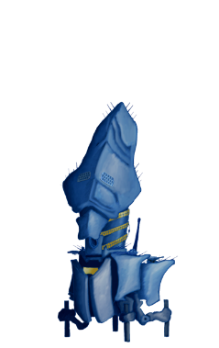
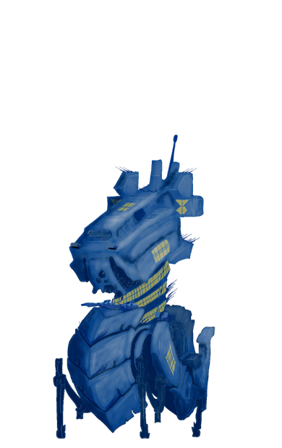
STRATEGOS Title
www.itim.unige.it/strategos
STRATEGOS integrates new technologies with enabling factors such
as IoT, IoE, Social Media, HBM to develop new Solutions
STRATEGOS is really Transdisciplinary and, thanks to its courses within Economics & Int.Affairs, teaches Engineers to work with Decision Makers
STRATEGOS is International, all in English, with Workshops in Virtual Labs, Simulation, RPG, Serious Games, eXtended Reality (VR/AR/MR)
STRATEGOS accepts all types of talents from Scientific & Engineering BS and provides assessments on the potential in Strategic Engineering
STRATEGOS for additional information www.itim.unige.it/strategos or contact us by email info.strategos@diten.unige.it
IoT Internet of Things
IoE Internet of Everything
HBM Human Behavior Models
RPG Role Playing Game
VR Virtual Reality
AR Augmented Reality
MR Mixed Reality

